Slide 1
a
Coefficient of Variation (CV) vs transcript abundance
CV curves
1.5
1.5
Method X
Method Y
CV
Smooth
CV
0
0 10
0
0 10
Average transcript abundance
Average transcript abundance
b
Quantification tools
Protocols-Platforms
6
Protocols-Platforms
Samples
cDNA-PacBio
H1-mix
H1-hESC
H1-DE
WTC11
ACVC
cDNA-ONT
dRNA-ONT
0
CapTrap-PacBio
CapTrap-ONT
Bambu
FLAIR
FLAMES
R2C2-ONT
IsoQuant
IsoTools
TALON
NanoSim
RSEM
cDNA-PacBio
CapTrap-PacBio
cDNA-Illumina
cDNA-ONT
dRNA-ONT
CapTrap-ONT
R2C2-ONT
cDNA-Ilumina
c
Bambu-merge
Bambu-LR
FLAIR
FLAMES
IsoQuant
IsoTools
TALON
NanoSim
RSEM
Bambu_LR
FLAIR
FLAMES
IsoQuant
IsoTools
TALON
NanoSim
Bambu
RSEM
CapTrap-ONT
CapTrap-PacBio
cDNA-ONT
cDNA-PacBio
H1-mix
dRNA-ONT
WTC11
R2C2-ONT
H1-hESC
cDNA-Illumina
H1-DE
CapTrap-ONT
1.5
CapTrap-PacBio
CV
0
0 10
cDNA-ONT
Transcript abundance
(log2(TPM-1))
cDNA-PacBio
dRNA-ONT
R2C2-ONT
cDNA-Illumina

Slide 2
Supplementary Figure S1_overall_irreproducibility. (Extended Data Fig. 54 in stage2_submission_version) Overall evaluation results of irreproducibility on real data with multiple replicates.
The diagram illustrates the calculation of irreproducibility. By fitting the coefficient of variation (CV) versus average transcript abundance into a smooth curve, it can be shown that Method X has lower coefficient of variation and higher reproducibility.
Evaluation results of ACVC metric for different quantification tools and protocols-platforms. Box plots are employed to illustrate the five-number summary of evaluation results across various datasets, depicting the minimum, lower quartile, median, upper quartile, and maximum values.
The overall results of CV curves with different transcript abundances on four samples (H1-mix, WTC11, H1-hESC and H1-DE) with different protocols and platforms. Here, Bambu-merge represents the transcript quantification using Bambu with GENCODE plus LR-specific annotation. And Bambu-LR represents the transcript quantification using only LR-specific annotation.

Slide 3
a
Replicate 1
Replicate 2
b
1
A
B
A
B
Isoform
Method X
5
7
0.9
3
Abundance
Method Y
C
D
C
D
Lowly expressed isoform
Consistency
0.1
0.5
0.05
0.2
0.5
E
F
G
E
F
G
Highly expressed isoform
3
0.9
10
0.7
0.9
7
* Set the abundance threshold as 1
Consistency =
n ({B, G} ∪ {C, D, F})
5
0
=
0 5 10
n ({A,B,C,D,E,F,G})
7
Abundance threshold
c
Quantification tools
Protocols-Platforms
10
Protocols-Platforms
Samples
cDNA-PacBio
H1-mix
H1-hESC
H1-DE
WTC11
ACC
cDNA-ONT
dRNA-ONT
7
CapTrap-PacBio
CapTrap-ONT
Bambu
FLAIR
FLAMES
R2C2-ONT
IsoQuant
IsoTools
TALON
NanoSim
RSEM
cDNA-PacBio
cDNA-Illumina
cDNA-ONT
dRNA-ONT
CapTrap-ONT
R2C2-ONT
CapTrap-PacBio
cDNA-Ilumina
d
Bambu-merge
Bambu-LR
FLAIR
FLAMES
IsoQuant
IsoTools
TALON
NanoSim
RSEM
Bambu_LR
FLAIR
FLAMES
IsoQuant
IsoTools
TALON
NanoSim
Bambu
RSEM
CapTrap-ONT
CapTrap-PacBio
cDNA-ONT
cDNA-PacBio
H1-mix
dRNA-ONT
WTC11
R2C2-ONT
H1-hESC
cDNA-Illumina
H1-DE
CapTrap-ONT
1
CapTrap-PacBio
Consistency
0
0 10
cDNA-ONT
Abundance threshold
(log2(TPM-1))
cDNA-PacBio
dRNA-ONT
R2C2-ONT
cDNA-Illumina

Slide 4
Supplementary Figure S2_overall_Consistency. (Extended Data Fig. 55 in stage2_submission_version) Overall evaluation results of consistency on real data with multiple replicates.
The diagram illustrates the calculation of consistency. By setting an expression threshold (i.e. 1 in this toy example), we can define which set of transcripts express (in blue) or not (in orange). This statistic is to measure the consistency of the expressed transcripts sets between replicates.
A toy example to show the consistency curves with different abundance threshold. Here, method X performs the better consistency of transcript abundance estimation across multiple replicates than method Y.
Evaluation results of ACC metric for different quantification tools and protocols-platforms. Box plots are employed to illustrate the five-number summary of evaluation results across various datasets, depicting the minimum, lower quartile, median, upper quartile, and maximum values.
The detailed evaluation results of consistency curves with different abundance thresholds on four samples (H1-mix, WTC11, H1-hESC and H1-DE) with different protocols and platforms.

Slide 5
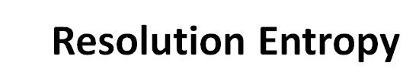
a
b
Counts
Transcript abundance
Supplementary Figure S3_Resolution_Entropy_description. (Extended Data Fig. 56 in stage2_submission_version) Resolution Entropy.
(a) The software output only a few certain discrete values has lower resolution entropy as it cannot capture the continuous and subtle difference of gene expressions.
(b) The software with continuous output values has higher resolution entropy

Slide 6
a
H1-mix: mix of H1-hESC and H1-DE cell at 0.8:0.2 ratio
Expectation: No difference across two groups
Metrics is to evaluate the similarity of two groups: (i) SCC; (ii) MRD; (iii) NRMSE
0.8*TPM_{H1-hESC}-0.2*TPM_{H1-DE} ≈ TPM_{H1-mix}
Group 1:
expected TPM
Group 2:
observed TPM
b
1.5
Quantification tools
Protocols-Platforms
Protocols-Platforms
Samples
cDNA-PacBio
H1-mix
H1-hESC
H1-DE
WTC11
NRMSE
cDNA-ONT
dRNA-ONT
0.3
CapTrap-PacBio
CapTrap-ONT
Bambu
FLAIR
FLAMES
R2C2-ONT
IsoQuant
IsoTools
TALON
NanoSim
RSEM
cDNA-PacBio
cDNA-Illumina
cDNA-ONT
dRNA-ONT
CapTrap-ONT
R2C2-ONT
CapTrap-PacBio
cDNA-Ilumina
c
Bambu FLAIR FLAMES IsoQuant IsoTools TALON NanoSim RSEM
CapTrap-ONT
CapTrap-PacBio
cDNA-ONT
cDNA-PacBio
10
Log2(Observed TPM-1)
dRNA-ONT
0
0 10
Log2(Expected TPM-1)
R2C2-ONT
cDNA-Illumina
Supplementary Figure S4_overall_cell_mixing_experiment. (Extended Data Fig. 57 in stage2_submission_version) Performance evaluation on cell mixing experiment.
Schematic diagram of evaluation strategy using the cell mixing experiment. Here, H1-mix was initially provided for quantification which was a mix of H1-hESC cells and H1-DE cells at an undisclosed ratio. After the initial submission, the individual H1-hESC and H1-DE samples were released and participants submitted quantifications for each.
Evaluation results of NRMSE metric for different quantification tools and protocols-platforms. Bar plots are utilized to visualize the mean values of evaluation results across diverse datasets, with error bars indicating the standard deviation of metrics.
Scatter plot of expected abundance and observed abundance for seven participant's tools with different protocols and platforms.

Slide 7
a
Quantification tools
Protocols-Platforms
1.0
Protocols-Platforms
Samples
cDNA-PacBio
H1-mix
H1-hESC
H1-DE
WTC11
NRMSE
cDNA-ONT
dRNA-ONT
0
CapTrap-PacBio
CapTrap-ONT
Bambu
FLAIR
FLAMES
R2C2-ONT
IsoQuant
IsoTools
TALON
NanoSim
RSEM
cDNA-PacBio
cDNA-Illumina
cDNA-ONT
dRNA-ONT
CapTrap-ONT
R2C2-ONT
CapTrap-PacBio
cDNA-Ilumina
b
Bambu-merge
Bambu-LR
FLAIR
FLAMES
IsoQuant
IsoTools
TALON
NanoSim
RSEM
Bambu_LR
FLAIR
FLAMES
IsoQuant
IsoTools
TALON
NanoSim
Bambu
RSEM
CapTrap-ONT
H1-mix
CapTrap-PacBio
WTC11
H1-hESC
cDNA-ONT
H1-DE
cDNA-PacBio
15
dRNA-ONT
Log2(Estimated TPM-1)
0
0 15
R2C2-ONT
Log2(True TPM-1)
cDNA-Illumina
CapTrap-ONT
CapTrap-PacBio
cDNA-ONT
cDNA-PacBio
dRNA-ONT
R2C2-ONT
cDNA-Illumina
Supplementary Figure S5_overall_SIRV-set4_data. (Extended Data Fig. 58 in stage2_submission_version) Performance evaluation on SIRV-set 4 data.
Evaluation results of NRMSE metric for different quantification tools and protocols-platforms. Bar plots are utilized to visualize the mean values of evaluation results across diverse datasets, with error bars indicating the standard deviation of NRMSE metric.
Scatter plot of true abundance and estimated abundance on SIRV-set 4 data with different protocols and platforms.

Slide 8
a
Simulators
Simulation data
Evaluation
NanoSim
(ONT)
IsoSeqSim
(PacBio)
cDNA-ONT
(Human)
cDNA-PacBio
(Human and Mouse)
SCC
MRD
RSEM
(Illumina)
dRNA-ONT
(Mouse)
cDNA-Illumina
(Human and Mouse)
NRMSE
b
Quantification tools
Protocols-Platforms
1.2
Protocols-Platforms
Samples
NRMSE
cDNA-PacBio
Human simulation
Mouse simulation
cDNA-ONT
0.1
dRNA-ONT
cDNA-Illumina
Bambu
FLAIR
FLAMES
IsoQuant
IsoTools
TALON
NanoSim
RSEM
cDNA-PacBio
cDNA-ONT
dRNA-ONT
cDNA-Ilumina
c
Bambu -merge Bambu-LR FLAIR FLAMES IsoQuant IsoTools TALON NanoSim RSEM
10
Log2(Estimated TPM-1)
Human simulation
0
0 10
Log2(TrueTPM-1)
cDNA-Illumina cDNA-PacBio dRNA-ONT cDNA-Illumina cDNA-PacBio cDNA-ONT
Mouse simulation
Supplementary Figure S6_overall_simulation_data. (Extended Data Fig. 59 in stage2_submission_version) Performance evaluation on simulation data.
The flow chart of simulation study.
Evaluation results of NRMSE metric for different quantification tools and protocols-platforms. Bar plots are utilized to visualize the mean values of evaluation results across diverse datasets, with error bars indicating the standard deviation of NRMSE metric.
Scatter plot of true abundance and estimated abundance on simulation data.

Slide 9
Mean NRMSE: 1.70
1.8
Protocols-Platforms
Mean NRMSE of LR-based tools: 0.62
cDNA-PacBio
NRMSE
cDNA-ONT
0.95
dRNA-ONT
cDNA-Illumina
Mean NRMSE: 0.52
Samples
Human simulation
Mouse simulation
0.10
Bambu
FLAIR
FLAMES
IsoQuant
IsoTools
TALON
NanoSim
RSEM
(Accurate annotation)
RSEM
(Inaccurate annotation)
Supplementary Figure S7_unaccurate_annotaion_impact_on_quantification. (Extended Data Fig. 60 in stage2_submission_version) Impact of annotation accuracy on transcript quantification. We assessed the performance of RSEM and LR-based tools (Bambu, FLAIR, FLAMES, IsoQuant, IsoTools, TALON, and NanoSim) with different annotations. The NRMSE metric was used to evaluate their performance on simulated data for human and mouse. For LR-based tools, the transcript quantification annotations were derived from sample-specific annotations identified by the participant using long-read RNA-seq data. As for RSEM, we present quantification results based on two annotations: a completely accurate annotation (i.e., the ground truth transcripts generated by the simulation data) and an inaccurate annotation (i.e., the common GENCODE reference annotation, which contains numerous false negative and false positive transcripts specific to the sample). Bar plots are utilized to visualize the mean values of evaluation results across diverse datasets, with error bars indicating the standard deviation of NRMSE metric.

Slide 10
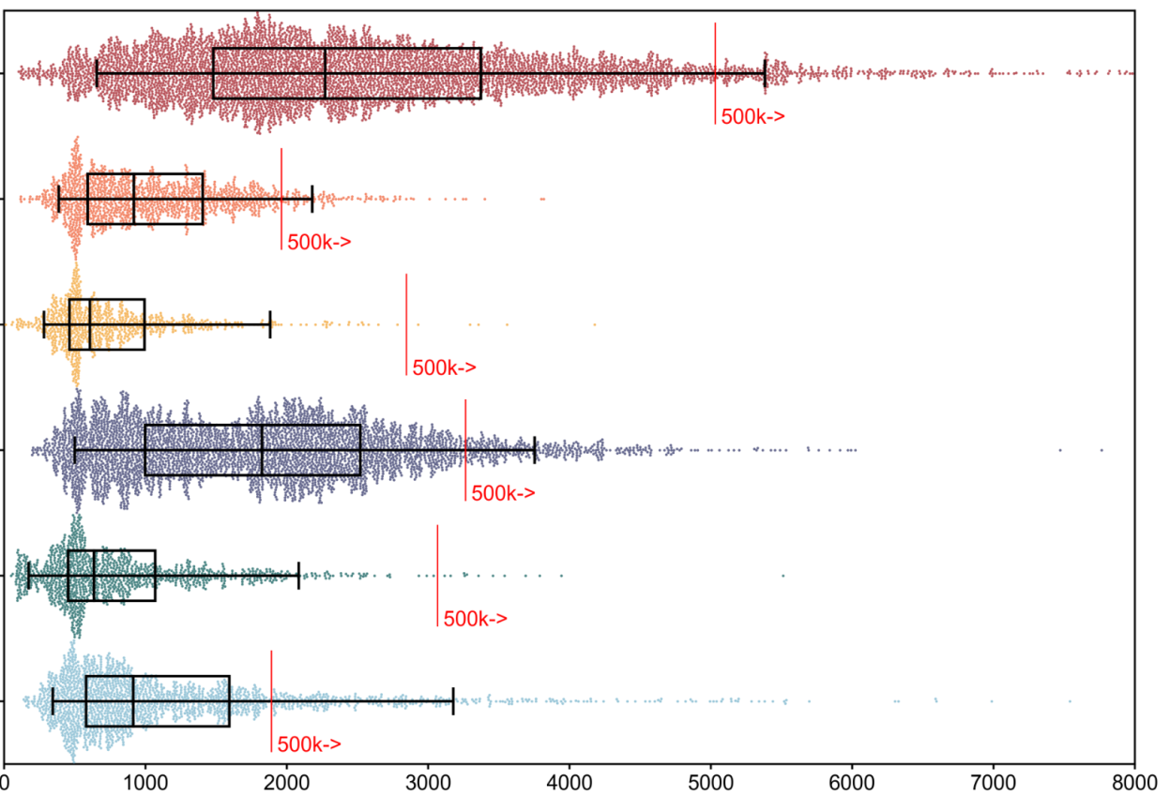
cDNA-PacBio
CapTrap-PacBio
CapTrap-ONT
R2C2-ONT
cDNA-ONT
dRNA-ONT
Read length (nt)
Supplementary Figure S8_length_distribution. (Extended Data Fig. 61 in stage2_submission_version) Read length distributions in six protocols-platforms.

Slide 11
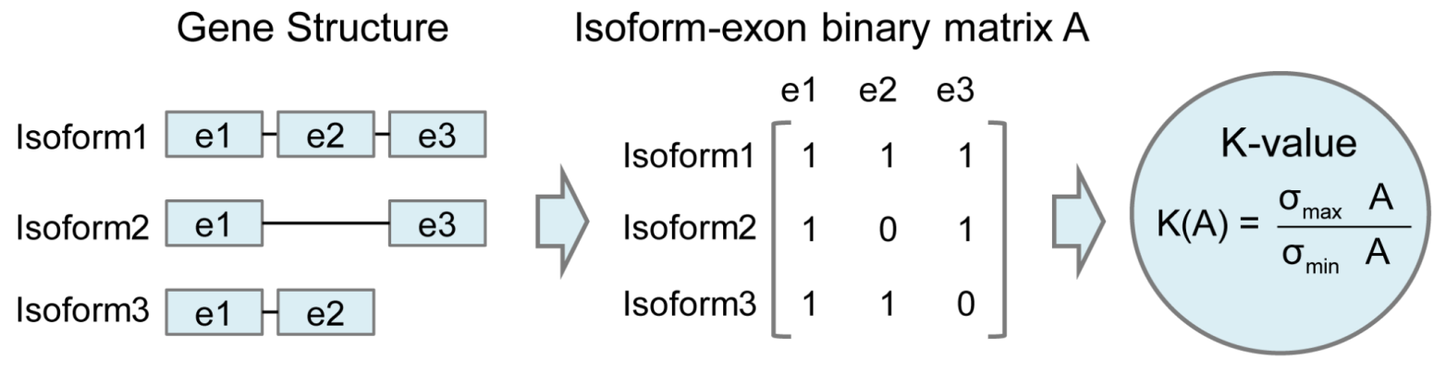
Supplementary figure S9_K-value_description. (Extended Data Fig. 62 in stage2_submission_version) Description of K-value. A measure of the complexity of exon-isoform structures for each gene.

